Slide 1
Children’s well-being
Being a parent in an ever changing world!
Notes:
Coffee and register

Slide 2
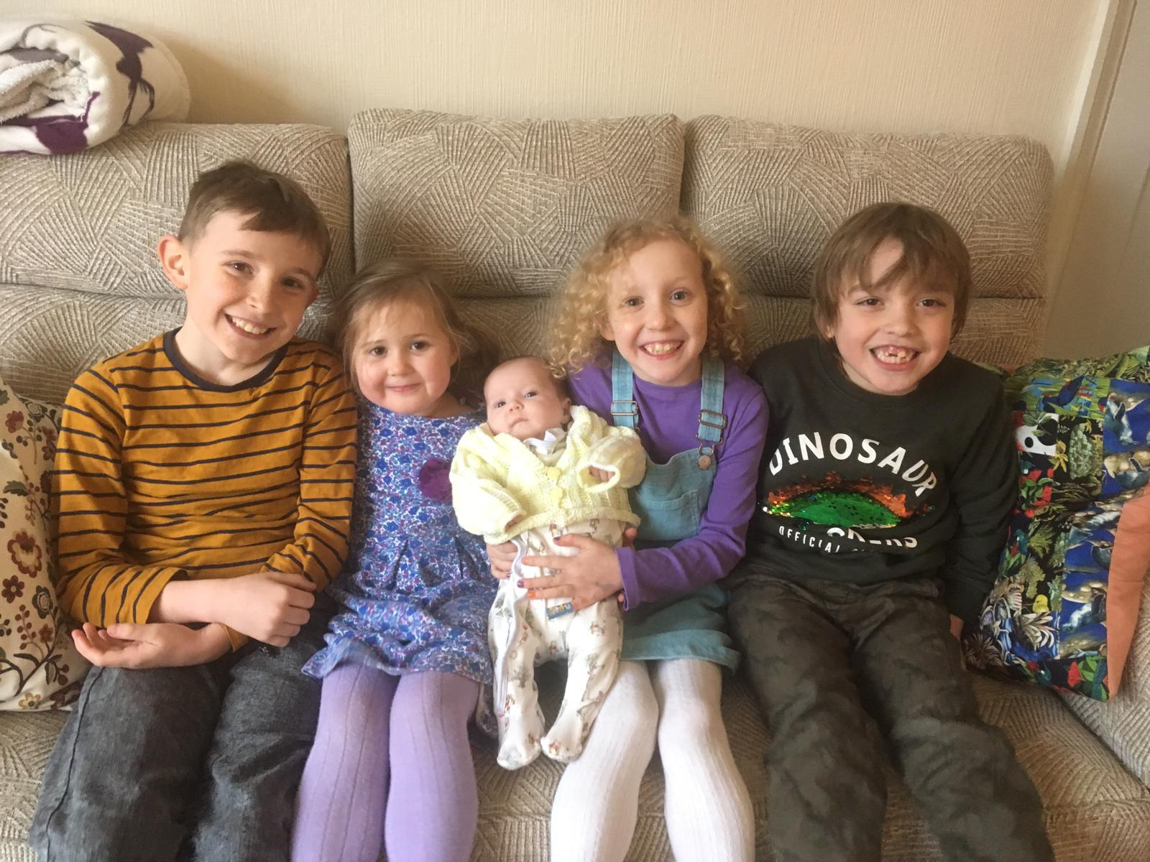
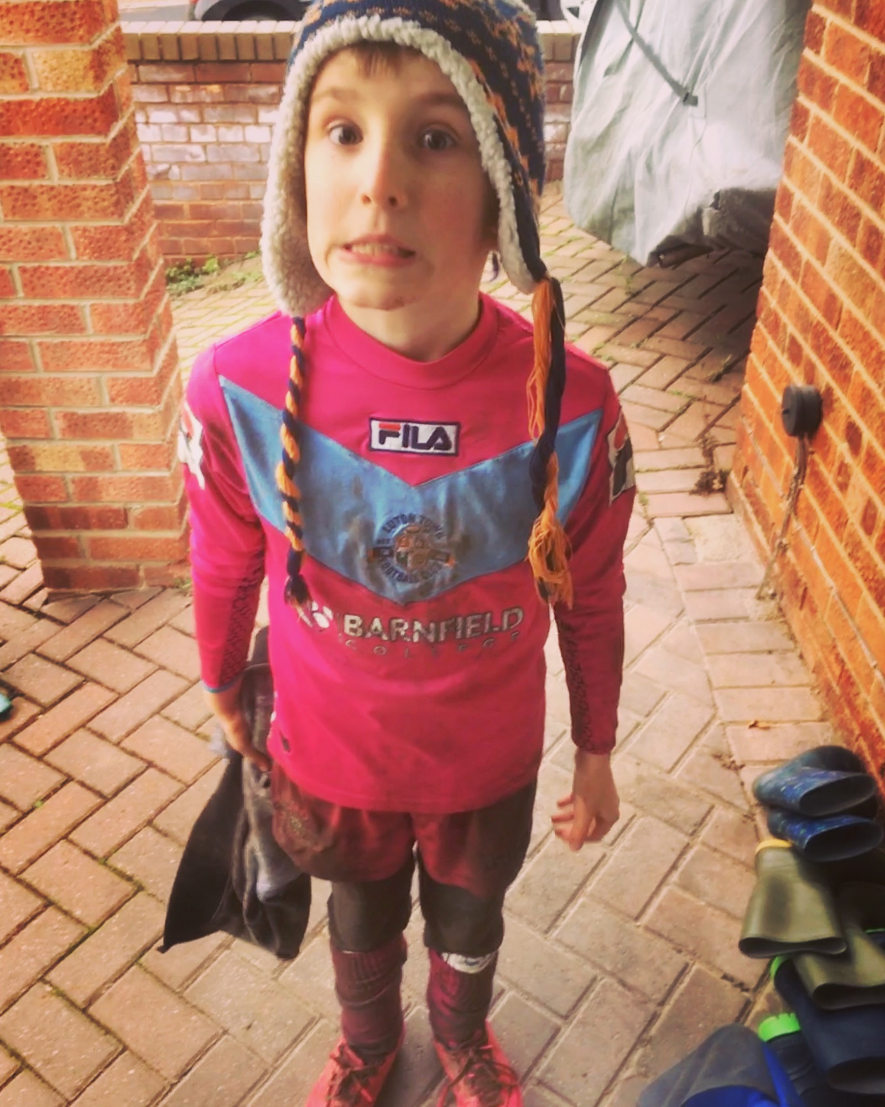
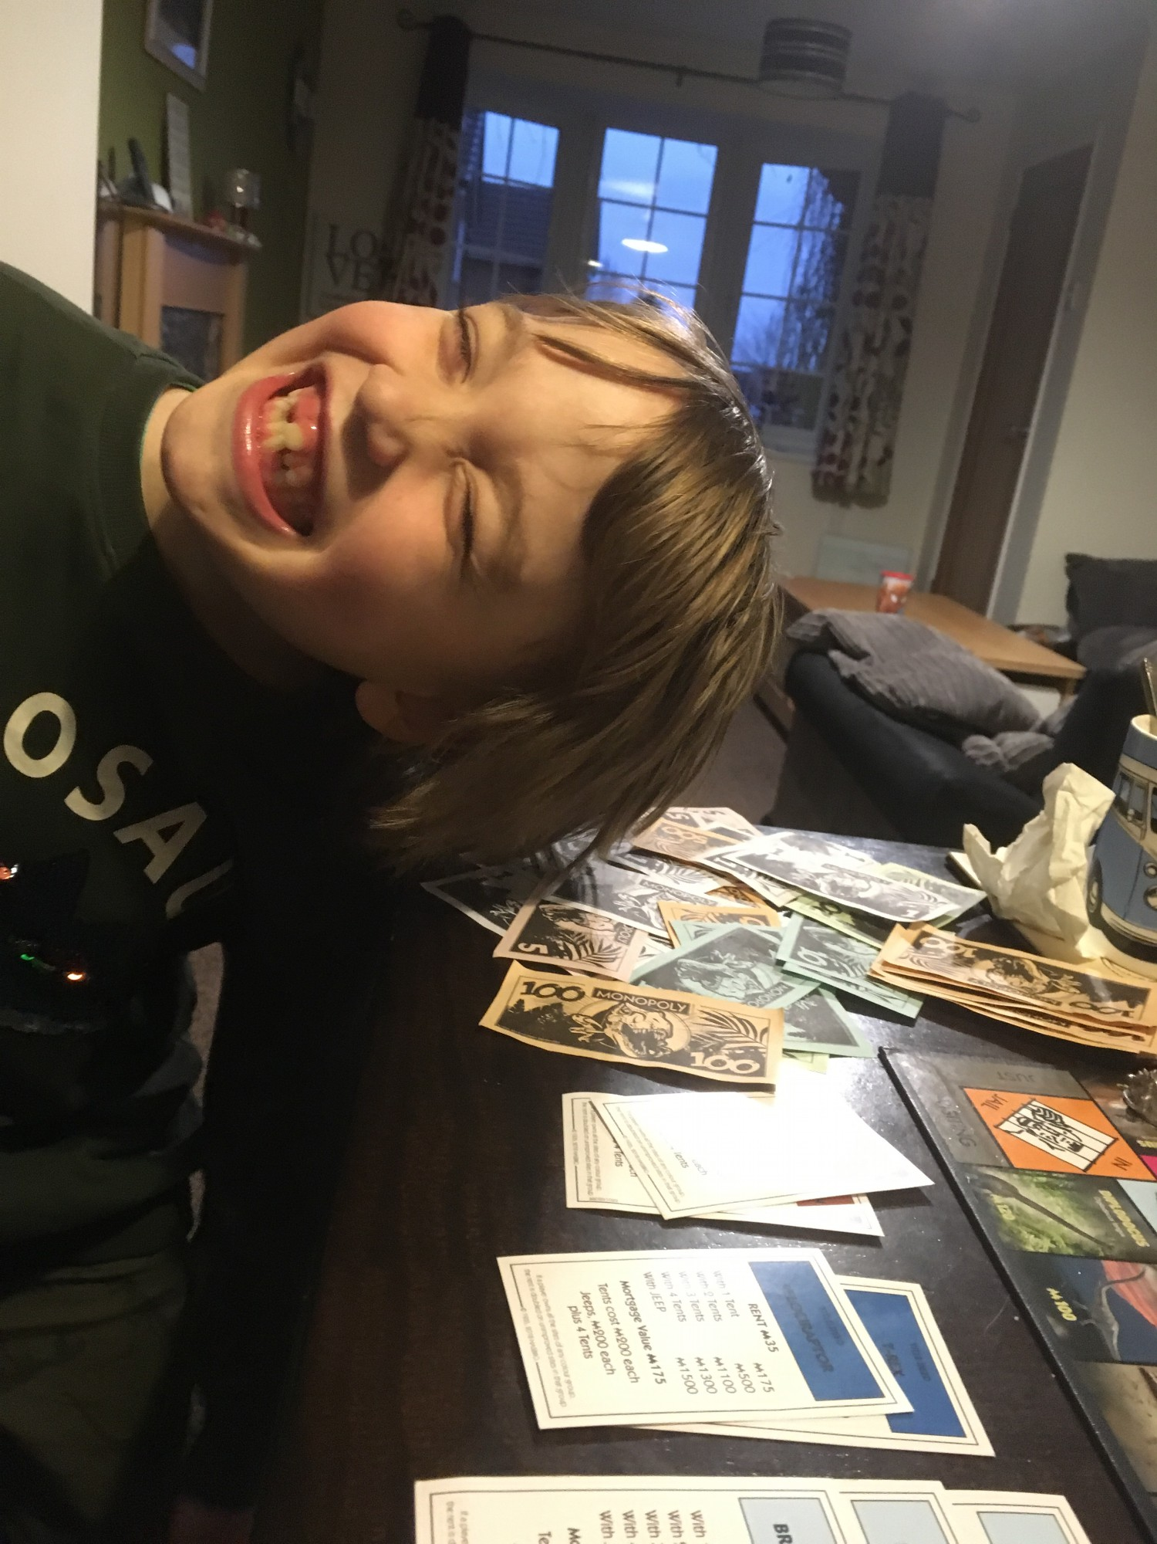
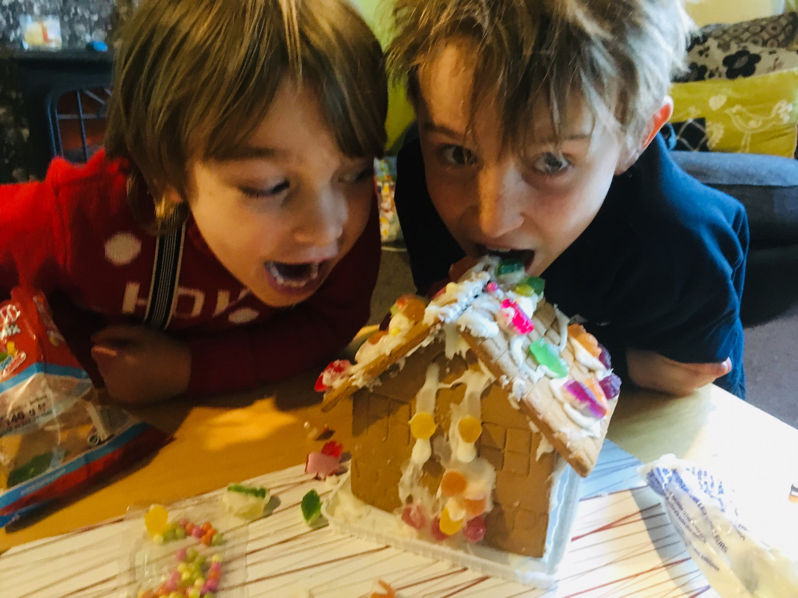
Who am I?
Notes:
Sendco_ special needs
Teacher
Mum
Aunty
Counselling
Leader AH

Slide 3

times are changing
Mental health, what is it?
What is well-being?
Notes:
Frightening statistics
Self harm
Anxiety
Depression
Social media-
Computing
Preparation not denial
Well being
Emotionally stable, know that pressures will hit you but give skills to cope

Slide 4
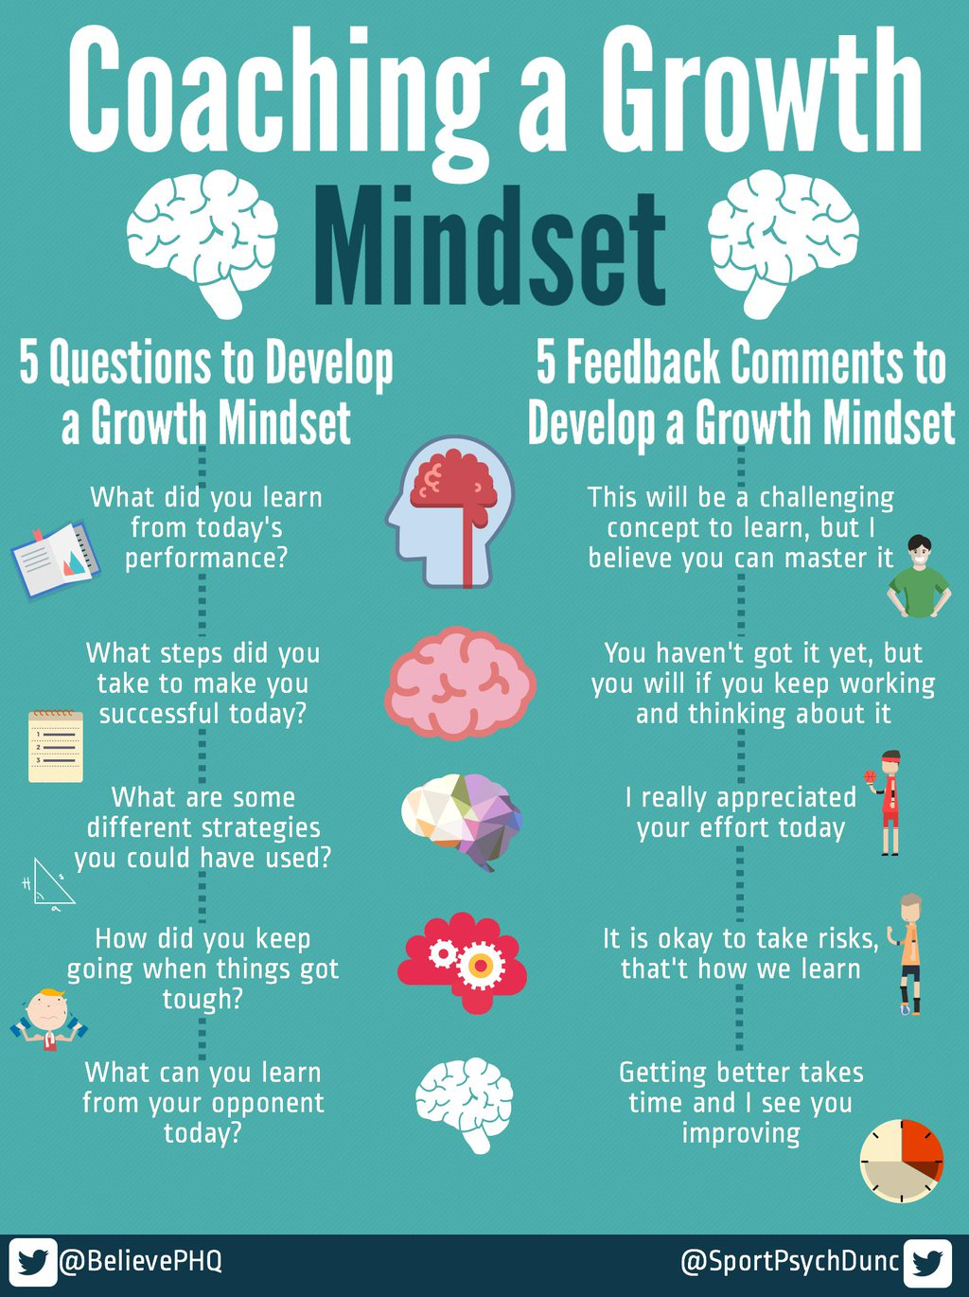
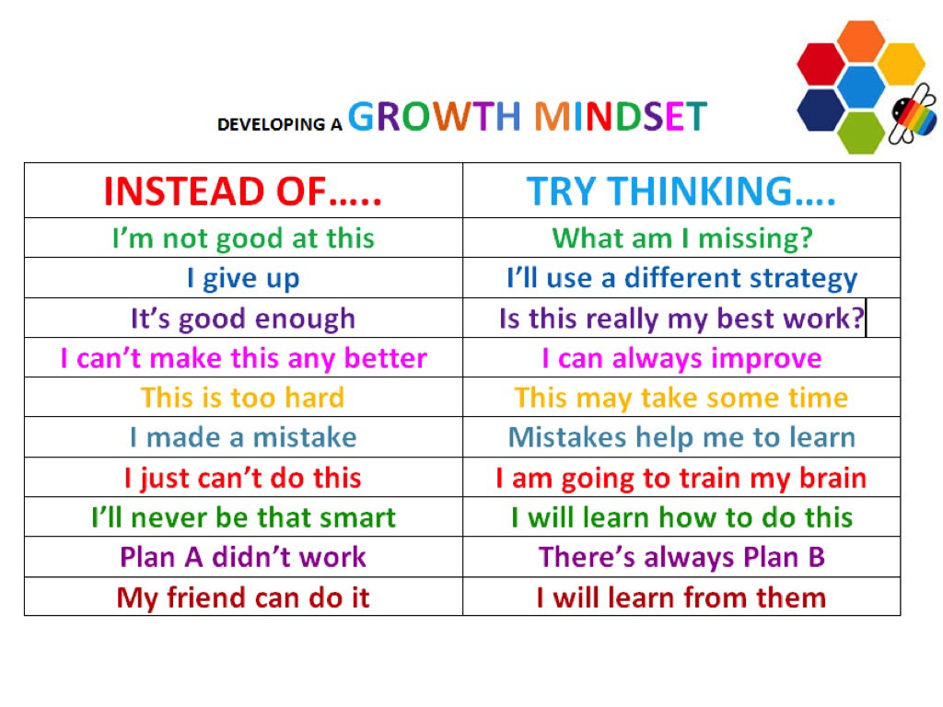
Growth mindset
Recap
Notes:
We embedded growth mindset as a principle

Slide 5

Emotion coaching
https://youtu.be/Lh0EE2_Y2io
Being sad…

Slide 6
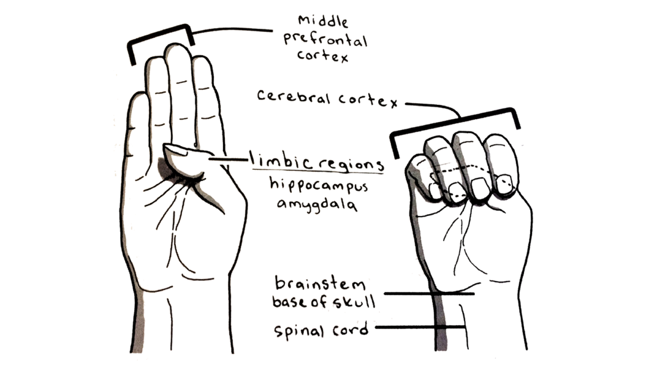
Flipping the lid
flipping the lid

Slide 7

What does this mean for your child?
There are times when they do not understand their emotions
Saying calm down will not help.
If the lid has gone time will help.
Prevention for flipping is the best… finding trigger.
Parent lids

Slide 8
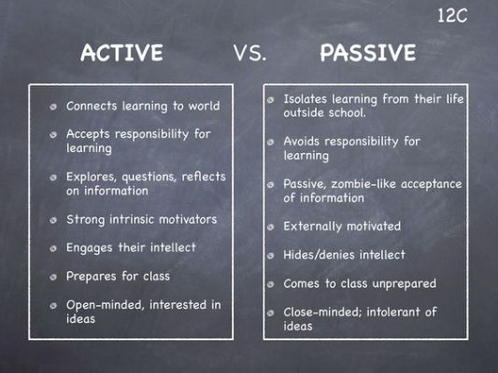
Active and passive listening to children
Active listening

Slide 9
Power of time and drawing
Maybe create your own inside out box
Spend some time colouring with your child
Ask them 3 stars and a wish- 3 good things about the day and 1 to improve

